Slide 1
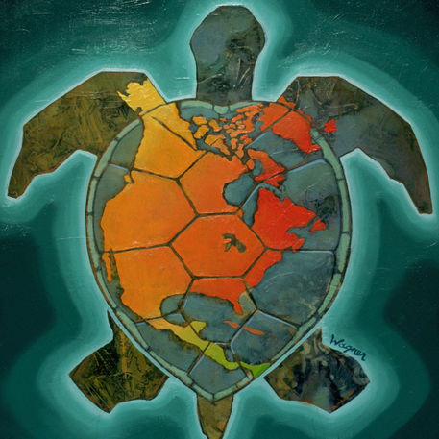
Indigenous Peoples’ Day Activities
October 7-13, 2015
Events at the University of Pittsburgh (Oakland)
For more information see: www.pghrights.org
Wed. Oct. 7, 5:00pm -- Native American leaders Chief Guyasuta and Logan the Mingo. An account of the history of Native American struggles in the Pittsburgh region. Hosted by the Native American Student Organization of the University of Pittsburgh, William Pitt Union, Rm. 837.
Sat. Oct. 10, 4:00 pm – Award-winning documentary Kanehsatake: 270 Years of Resistance, commemorating the 25th anniversary of Kanehsatake Mohawk resistance in Quebec. William Pitt Union, Rm 548
Mon. Oct. 12, 7:00pm -- Indigenous Peoples’ Day and Global-Local Struggles for Dignity and Human Rights. Leaders from the Council of Three Rivers American Indian Center will discuss Indigenous Peoples’ Day and its connections to global Indigenous peoples’ movements and movements for global social justice and human rights. Posvar Hall (off Schenley Plaza), Rm 4130
Mon. Oct. 12 & Tues. Oct. 13 -- CONFLICT KITCHEN. Special Native American menu and events, Schenley Plaza, Pittsburgh

